Slide 1
Predicting Customer Churn in Bank
Vaishnavi Paineni

Slide 2

Objective
What is customer churn?
Why is the prediction of customer churn important?
How does this prediction help?

Slide 3
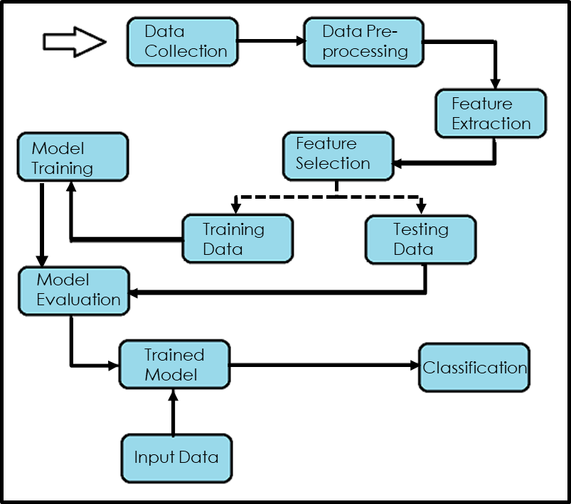
ML Pipeline

Slide 4
Data Collection
The dataset used for this project is “Bank Customer Churn” from Kaggle.
https://www.kaggle.com/datasets/radheshyamkollipara/bank-customer-churn/
The dataset comprises various attributes, encompassing individual customer details such as customer ID, surname, gender, and age. Additionally, it includes pertinent banking information like tenure, balance, estimated salary, and indicators such as whether the individual possesses a credit card, among other relevant factors

Slide 5
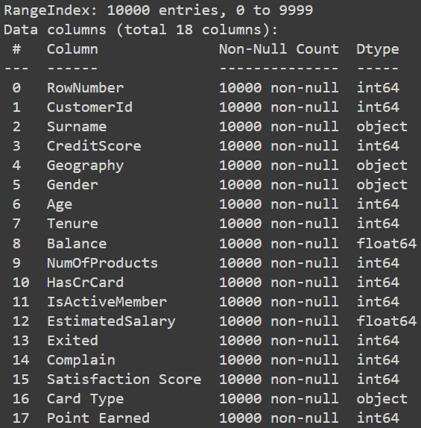
Data Cleaning
As you can see, the dataset has way too many attributes and some of them do not affect the customer churn.
Drop: Customer ID, Surname, RowNumber, Complain, Satisfaction Score, Card Type, Points, Earned.

Slide 6
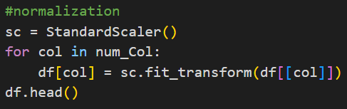
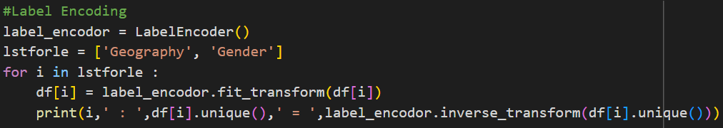
Data Preprocessing
In this step, we perform data transformation by label encoding categorical features and standardizing the scales for the numerical features.
Encoding: Geography and Gender
Normalization: Salary, Balance, Credit Score, Age

Slide 7
Analysis of Categorical Features
Analysis of Numerical Features
Features 'HasCrCard', 'IsActiveMember', 'Geography', 'Gender', 'NumOfProducts', and 'Tenure' are individually explored through visual representations showcasing their impact on churn. Insights present churn percentages within each category of these features, providing a clear understanding of their influence on customer churn.
Examined key numerical features including 'EstimatedSalary', 'Balance', 'CreditScore', and 'Age' via histograms and kernel density estimations (KDE).

Slide 8
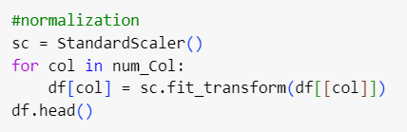
Feature Engineering
Using Standard Scalar from scikit-learn, we Normalized the numerical features.
The 'sc.fit_transform' function standardizes the data by adjusting its distribution so that the mean is 0 and standard deviation is 1.
This transformation is necessary to put all these features on a similar scale.

Slide 9
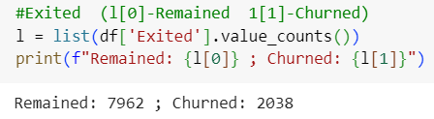
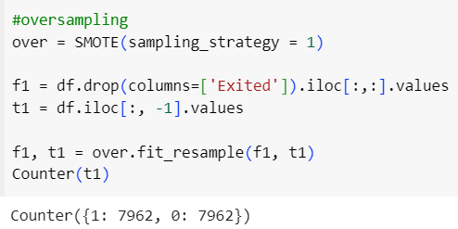
SMOTE
Oversampling is a technique used in machine learning to address class imbalance by increasing the number of instances in the minority class(es) to prevent bias toward the majority class in the model.
Here we use SMOTE(Synthetic Minority Over Sampling Technique) to achieve this.

Slide 10
Model Training
Process of teaching a machine learning algorithm to recognize patterns in data.
RunModel()
Training a machine learning classifier
Making predictions
Evaluating performance using cross-validation
Facilitates the training of various classifiers, including
Logistic Regression
Random Forest
K-Nearest Neighbors
Decision Tree
Support Vector Machine
XGBoost

Slide 11
Model Evaluation
Evaluating models is crucial for understanding how well they generalize to new, unseen data.
model_evaluation()
Evaluates models using metrics such as
Confusion matrices
Precision
Recall
F1-score

Slide 12
Results
Model | Cross Validation Score | ROC-AUC Score | Accuracy
Logistic Regression | 77.15% | 68.93% | 69%
Random Forest | 96.24% | 90.96% | 91%
KNN | 91.56% | 84.61% | 85%
Decision Tree | 84.76% | 84.50% | 85%
SVM | 84.97% | 76.94% | 77%
XGBoost | 95.87% | 89.81% | 90%

Slide 13
Questions?

